Slide 1
Binary Trees
Introduction

Slide 2
What is a Tree?
Definition: A hierarchical data structure with nodes arranged in levels.
Rooted Structure: Starts with a root node and branches into child nodes.
Non-linear: Unlike arrays or linked lists, trees are non-linear and can represent complex relationships.
Diagram: Basic tree structure
Root
/ \
Node1 Node2
Notes:
This presentation will introduce the concept of trees in data structures, highlighting their characteristics, types, and real-world applications.
A tree is a data structure made up of nodes connected in a hierarchical manner.
The root node serves as the starting point, from which nodes branch out, making it different from linear structures like arrays.

Slide 3
Example of a Simple Tree
Root Node: 1
Leaf Nodes: 4, 5, 6, 7
Internal Nodes: 2, 3
1
/ \
2 3
/ | | \
4 5 6 7

Slide 4
Characteristics of a Tree
Root Node: The topmost node in the tree.
Parent-Child Relationship: Each node can have one parent and multiple children.
Leaf Nodes: Nodes without children (at the "leaves" of the tree).
Height and Depth: Measures of the tree’s levels and distance from the root.

Slide 5
Key Terms in Tree Structures
Root: The first (top) node of the tree.
Node: Basic unit of the tree, containing data and links to other nodes.
Edge: Connection between nodes (parent to child).
Path: Sequence of nodes from one node to another.
Height: Longest path from a node to a leaf.
Depth: Distance of a node from the root.
Visualization of Tree
A
/ \
B C
/ \ \
D E F
/ \
G H
Notes:
Trees provide a structured and efficient way to store hierarchical data, making them crucial for various applications in computing.
Path from A to H: A → B → D → G (length = 3 edges)
Height of node A: 4 (the longest path A → B → D → G)
Height of node D: 2 (the longest path D → G or D → H)
Depth of node G: 3 (the path A → B → D → G)

Slide 6
Importance of Trees in Data Structures
Hierarchical Data Representation: Useful for representing real-world hierarchies (e.g., file systems, organization charts).
Efficient Operations: Support efficient searching, insertion, and deletion.
Flexible Structure: Easy to expand and modify as needed.
Notes:
Trees provide a structured and efficient way to store hierarchical data, making them crucial for various applications in computing.

Slide 7
Common Types of Trees
Binary Tree: Each node has at most 2 children.
Binary Search Tree (BST): Binary tree with sorted nodes for fast lookup.
AVL Tree: A self-balancing binary search tree.
B-tree: Used in databases, optimized for systems with slow storage.
Heap: Complete binary tree used for efficient priority handling.
Notes:
Trees provide a structured and efficient way to store hierarchical data, making them crucial for various applications in computing.
Path from A to H: A → B → D → G (length = 3 edges)
Height of node A: 4 (the longest path A → B → D → G)
Height of node D: 2 (the longest path D → G or D → H)
Depth of node G: 3 (the path A → B → D → G)

Slide 8
Applications of Trees
File Systems: Organizing directories and files.HTML/XML Parsing:
Representing nested document structures.
Databases: B-trees for efficient data storage and retrieval.
AI/Game Development: Decision trees for strategic choices.
Notes:
Trees provide a structured and efficient way to store hierarchical data, making them crucial for various applications in computing.
Path from A to H: A → B → D → G (length = 3 edges)
Height of node A: 4 (the longest path A → B → D → G)
Height of node D: 2 (the longest path D → G or D → H)
Depth of node G: 3 (the path A → B → D → G)

Slide 9
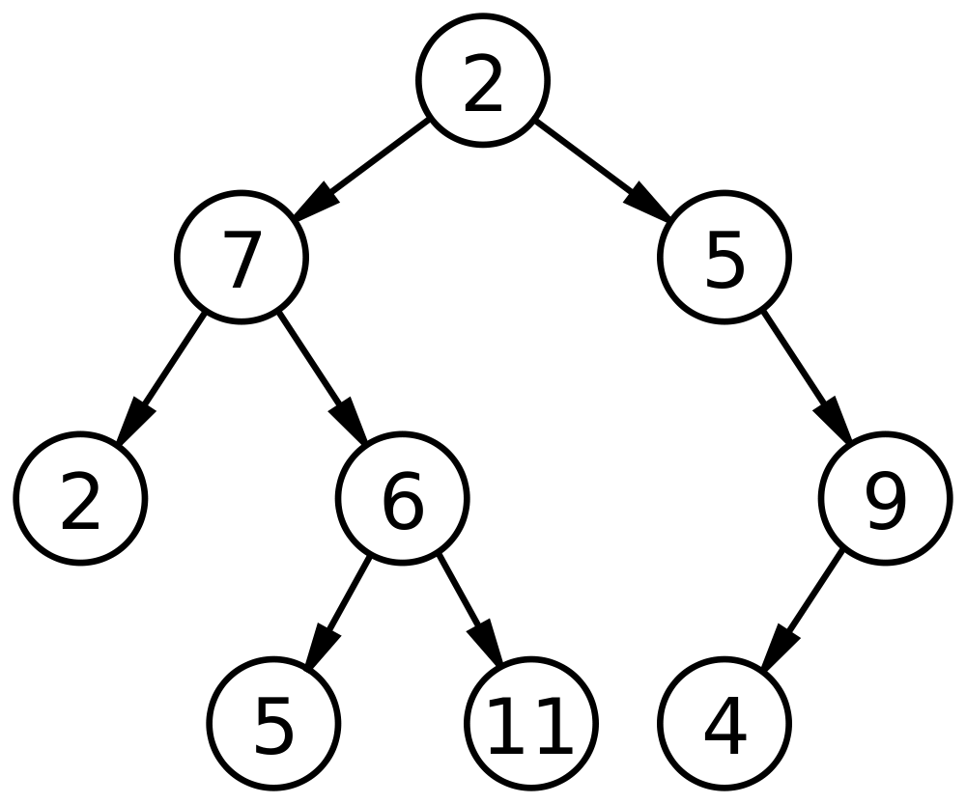
Binary Tree
A binary tree is a tree data structure in which each node has at most two children, which are referred to as the left child and the right child.

Slide 10
Binary Tree Traversals
Tree Traversal: Process of visiting (checking and/or updating) each node in a tree data structure, exactly once.
Unlike linked lists, one-dimensional arrays etc., which are canonically traversed in linear order, trees may be traversed in multiple ways. They may be traversed in depth-first or breadth-first order.
There are three common ways to traverse them in depth-first order: in-order, pre-order and post-order.

Slide 11
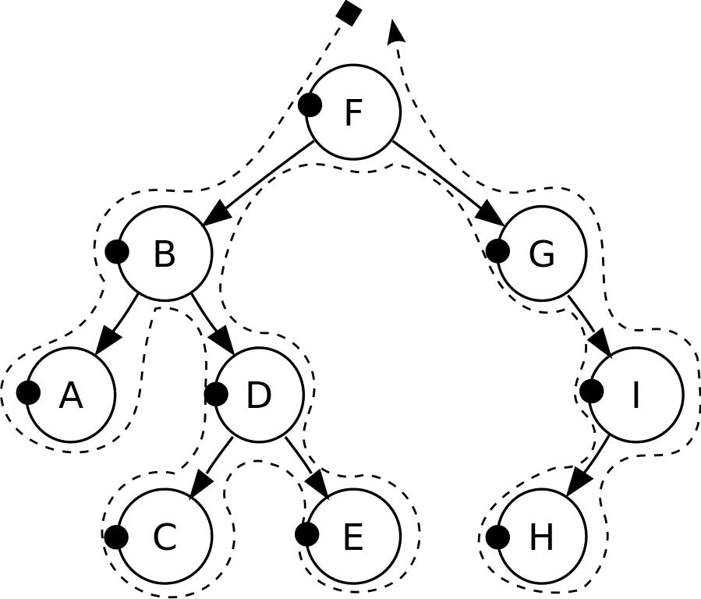
Pre-order Traversal
Check if the current node is empty / null.
Display the data part of the root (or current node).
Traverse the left subtree by recursively calling the pre-order function.
Traverse the right subtree by recursively calling the pre-order function.
Pre-order: F, B, A, D, C, E, G, I, H.

Slide 12
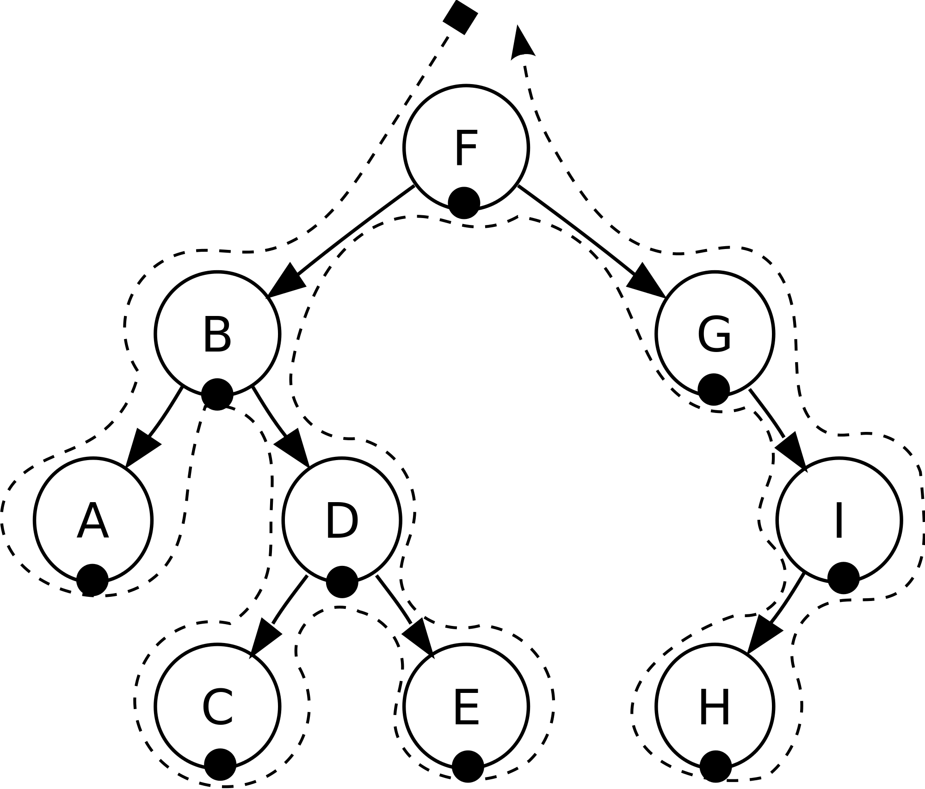
In-order Traversal
Check if the current node is empty / null.
Traverse the left subtree by recursively calling the in-order function.
Display the data part of the root (or current node).
Traverse the right subtree by recursively calling the in-order function.
In-order: A, B, C, D, E, F, G, H, I.

Slide 13

Post-order Traversal
Check if the current node is empty / null.
Traverse the left subtree by recursively calling the post-order function.
Traverse the right subtree by recursively calling the post-order function.
Display the data part of the root (or current node).
Post-order: A, C, E, D, B, H, I, G, F.

Slide 14
Level-order Traversal

Slide 15
Level-order traversal
Level-order traversal:
1,2,3,4,5
1
2
3
4
5

Slide 16
Level-order traversal
Level-order traversal:
1,
1
2
3
4
5
1

Slide 17
Level-order traversal
1
2
2
3
1
4
5
3

Slide 18
Level-order traversal
Level-order traversal:
1,2
1
2
3
4
5
2
3

Slide 19
Level-order traversal
1
4
2
3
2
4
5
5
3

Slide 20
Level-order traversal
Level-order traversal:
1,2,3
1
2
3
4
5
3
4
5

Slide 21
Level-order traversal
Level-order traversal:
1,2,3,4
1
2
3
3
4
5
4
5

Slide 22
Level-order traversal
Level-order traversal:
1,2,3,4,5
1
2
3
4
4
5
5

Slide 23
Level-order traversal
1
2
3
5
4
5

